Slide 1
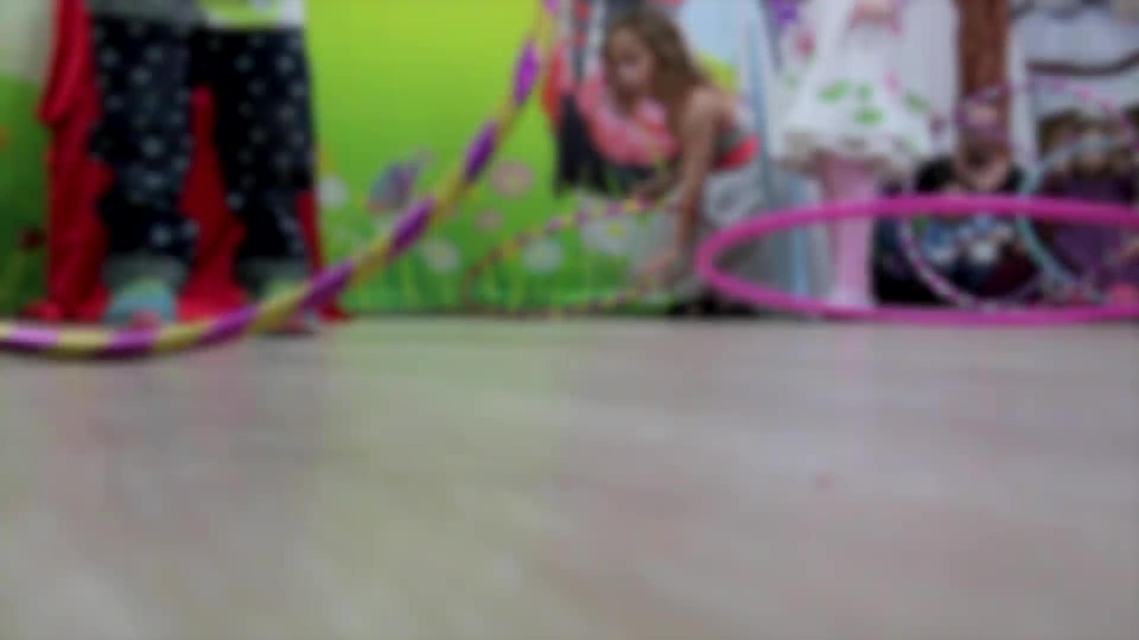

Micah Carroll - GWDA273

Slide 2
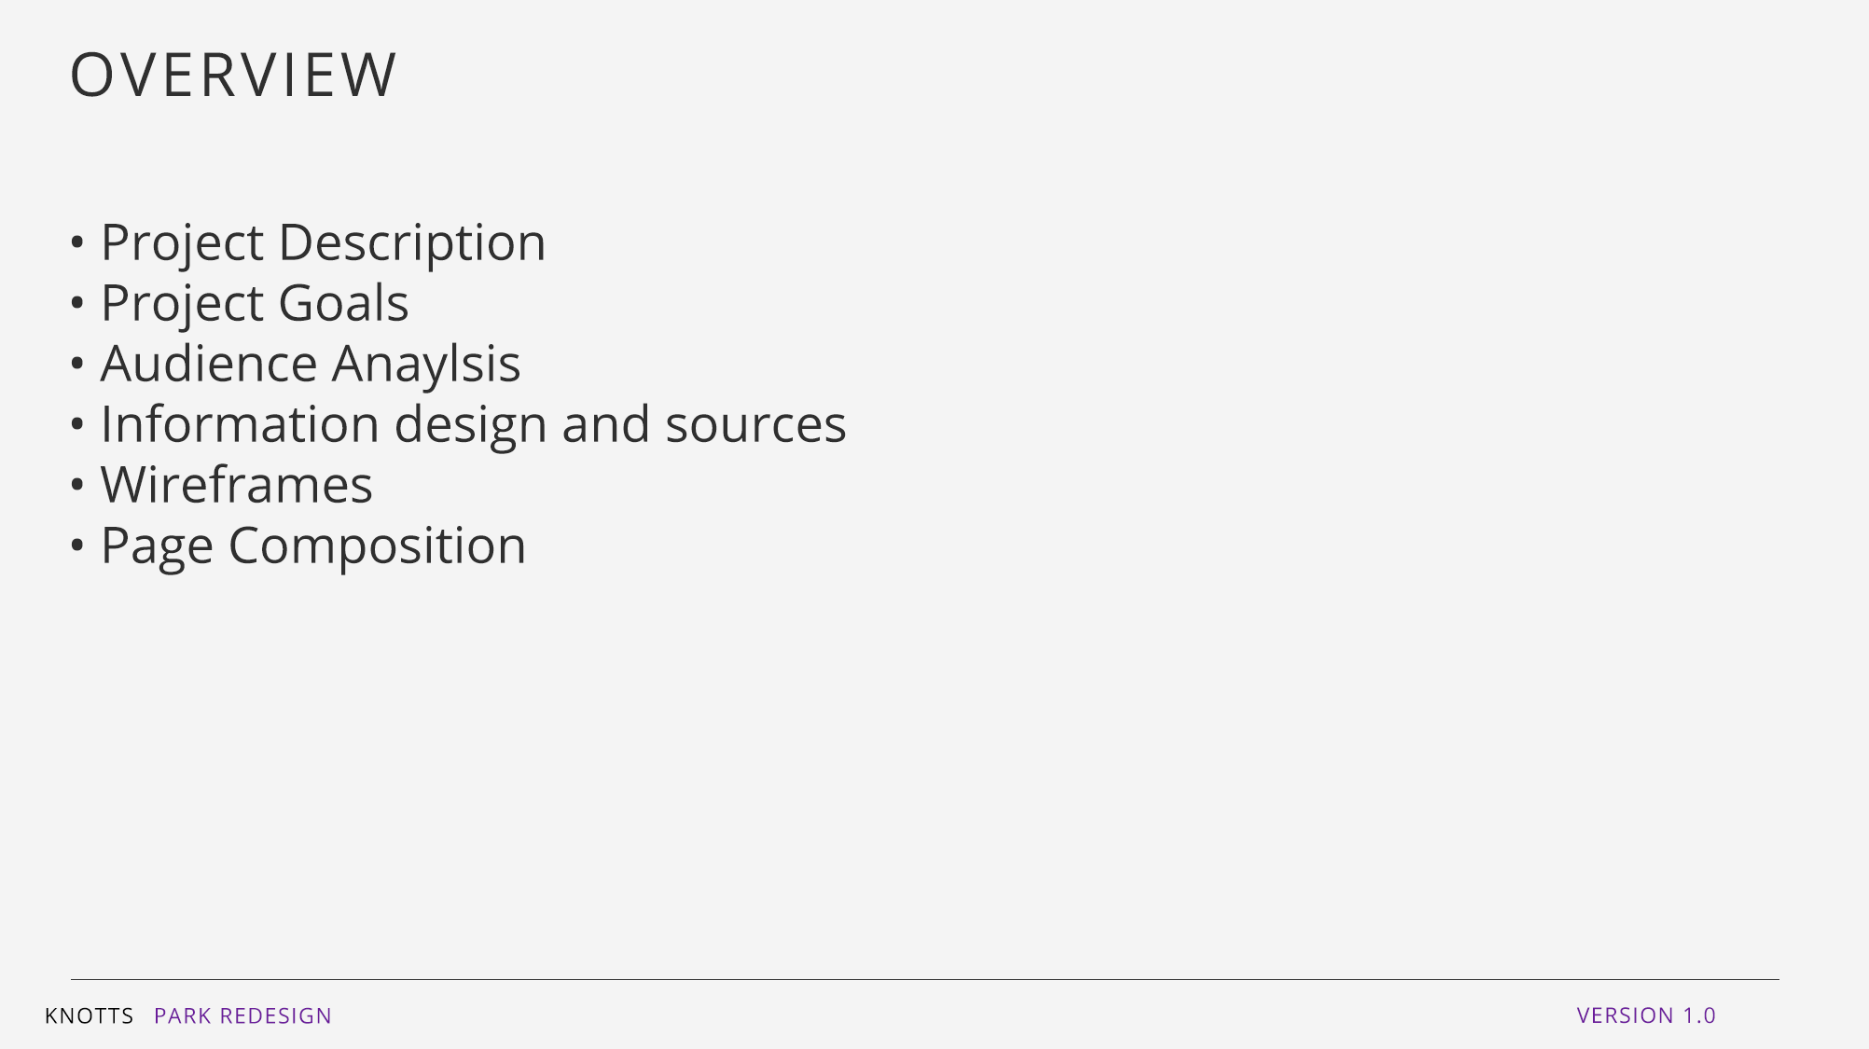
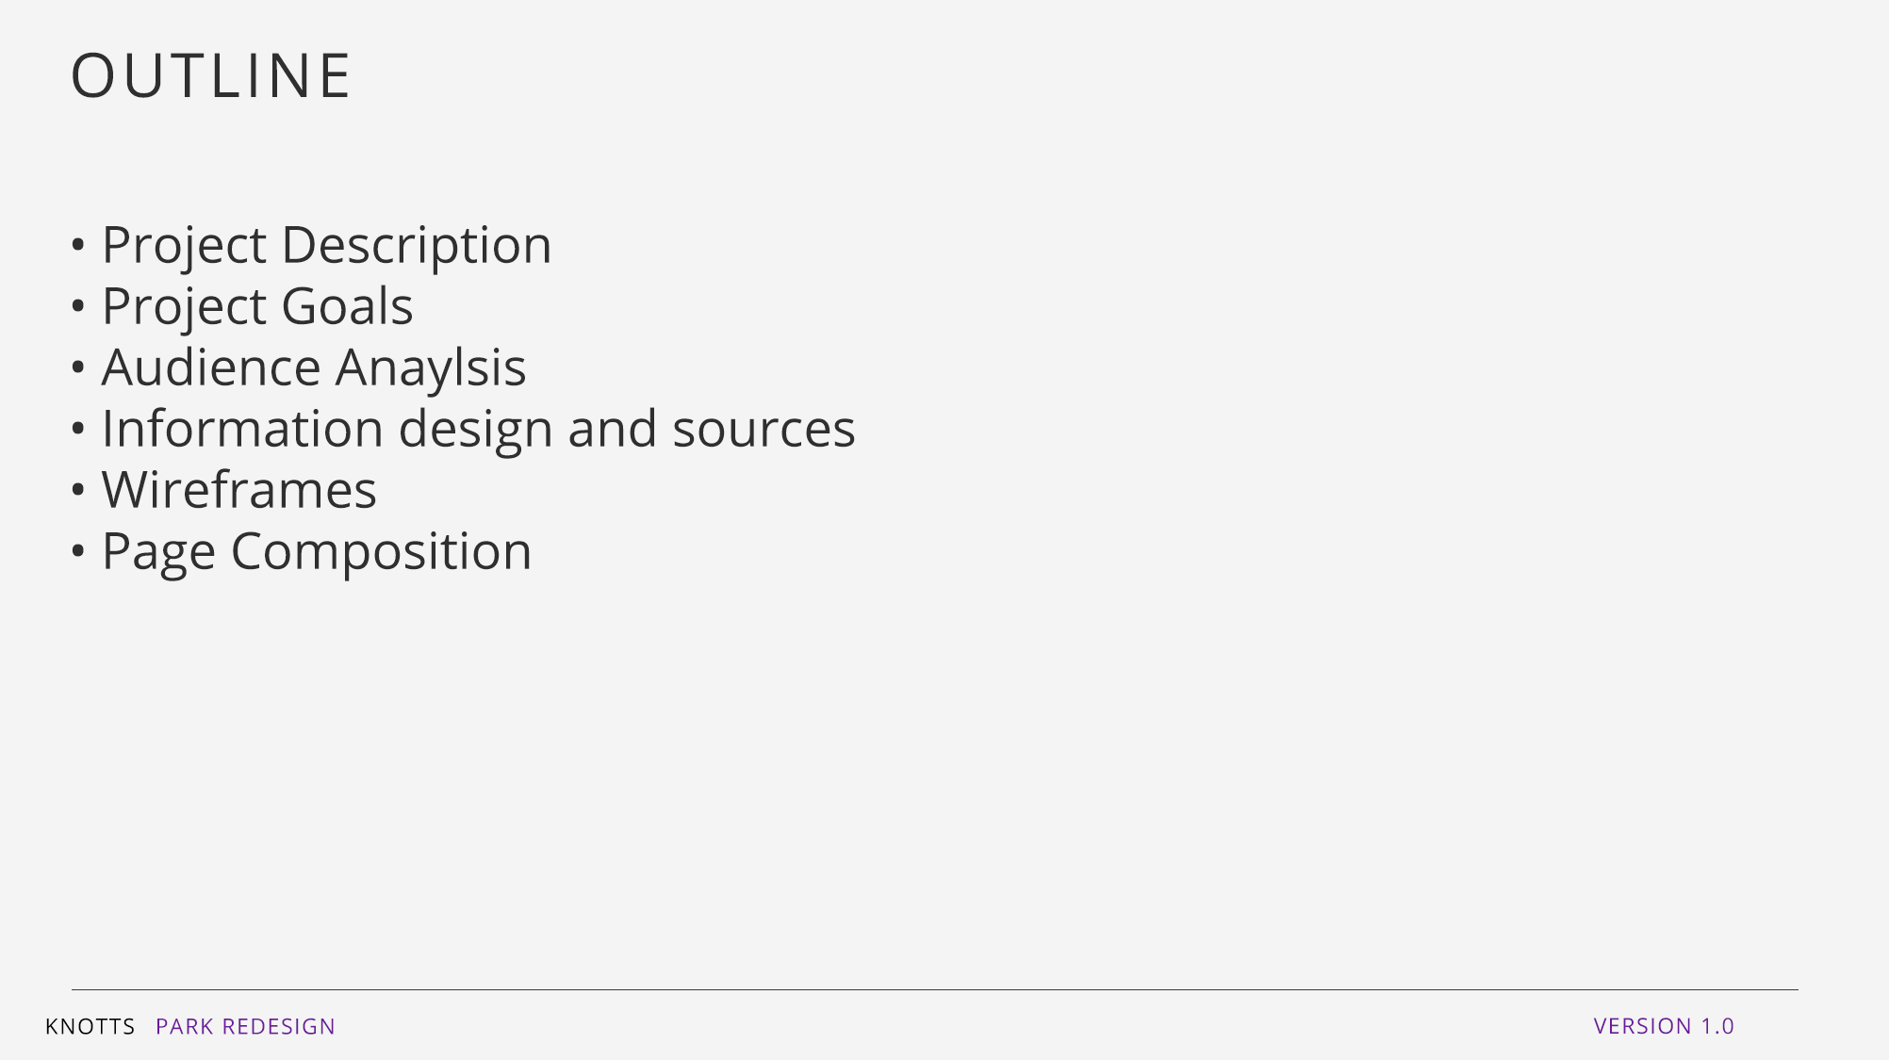
OUTLINE
Project Description
Project Goals for the Redesign
Project Goals
Audience Analysis
Information Design & Sources
Wireframes
Page Comp

Slide 3
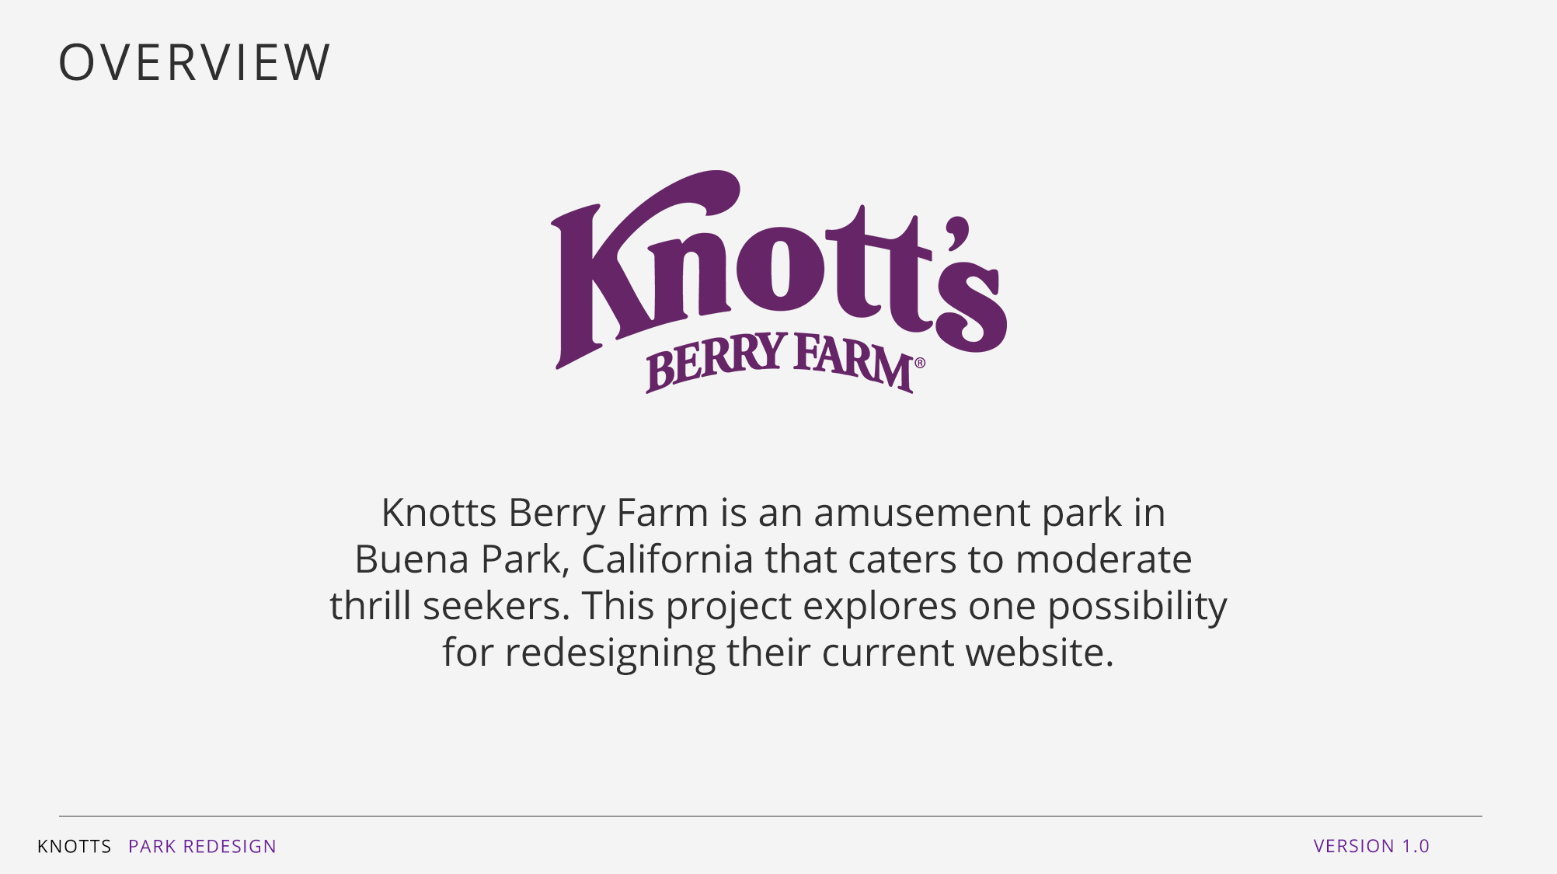
OVERVIEW
Knotts Berry Farm is an amusement park in Buena Park, California that caters to moderate thrill seekers. This project explores one possibility for redesigning their current website.
https://www.knotts.com/

Slide 4
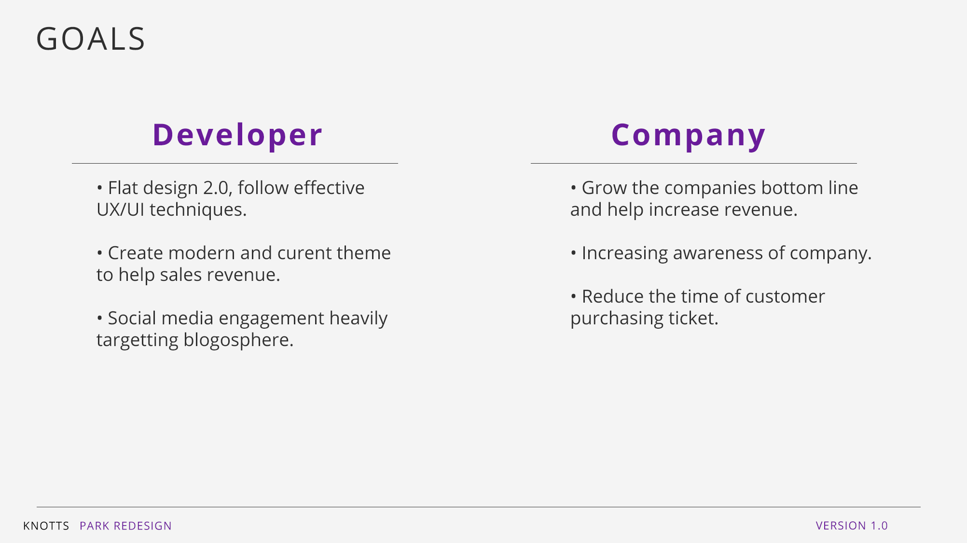
GOALS
DEVELOPER
COMPANY
Flat Design 2.0 , Follow effective UI/UX techniques.
Create a modern and current theme to help increase sales.
Social Media engagement, heavily targeting improving blogosphere.
Audience goals to quickly find ticket pricing.

Slide 5
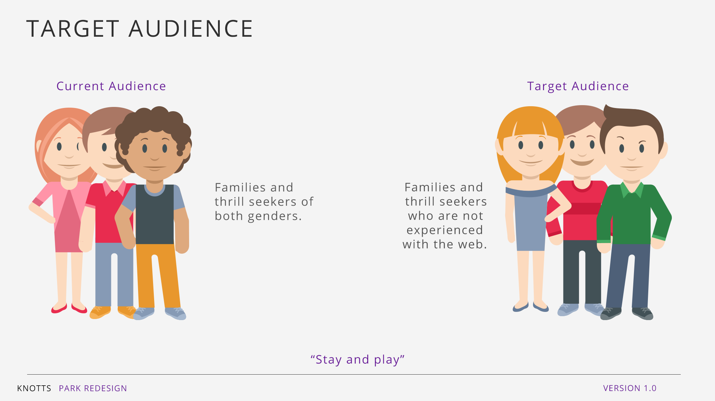
TARGET AUDIENCE
Current audience:
Families and thrill seekers of both genders.
Target audience for redesign
Families / Thrill Seekers who are not experienced in the web.
“Question” they ask their audience.
“Stay and Play”
Spend the entire day and night having fun at our park.

Slide 6
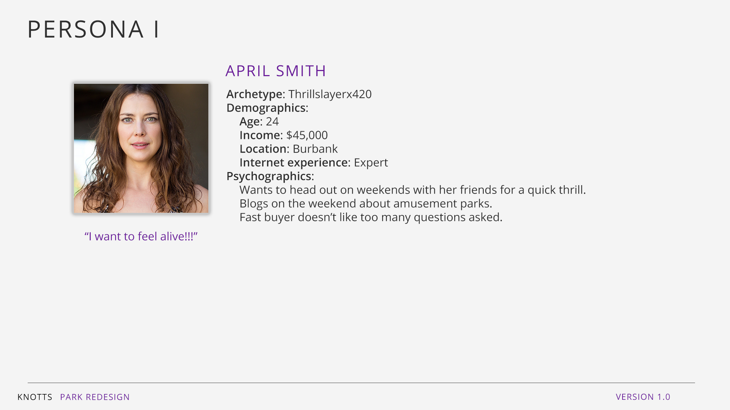
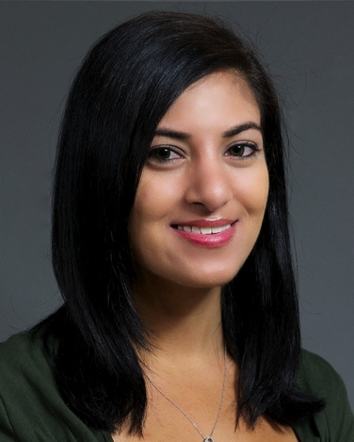
PERSONA I
Name: April Smith
Archetype: Thrillslayerx01x
Demographics
Age : 23
Income: $ 45,000
Location: Burbank
Internet experience: Expert
Psychographics
Wants to head out on the weekends with her friends for a quick thrill.
Blogs on the weekend about amusement parks.
“ I want to feel alive !”

Slide 7
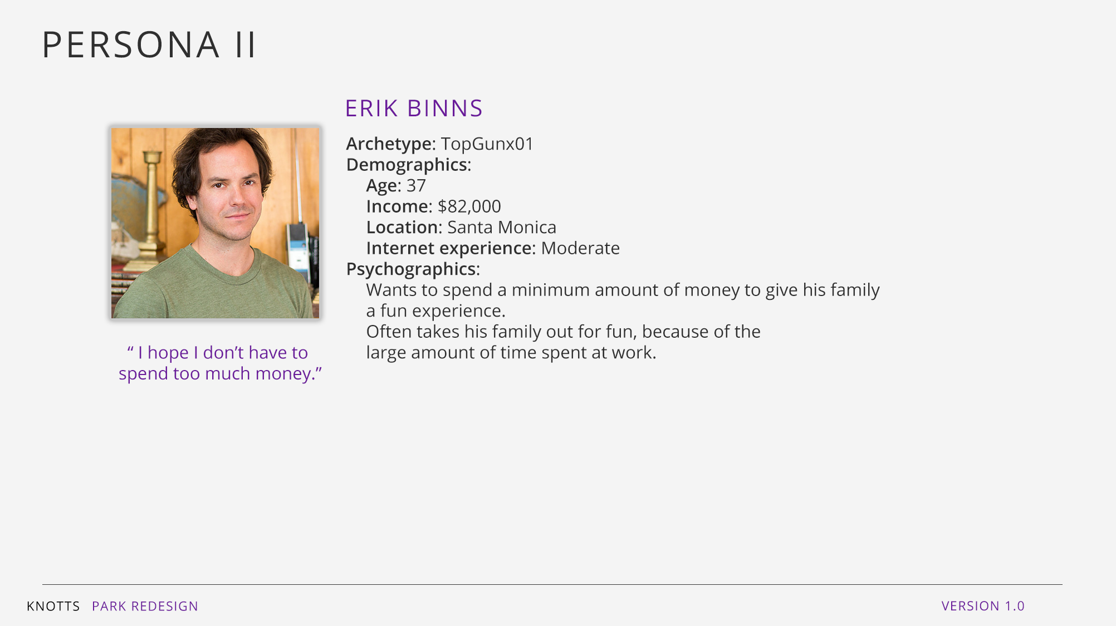
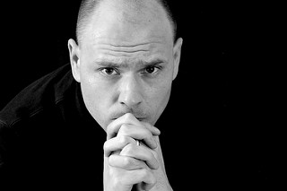
PERSONA II
Name: Erik Binns
Archetype: TopGunx01
Demographics
Age : 37
Income: $ 82,000
Location: Santa Monica
Internet experience: Moderate
Psychographics
Wants to spend a minimum amount of money to give his family a fun experience.
Often takes his family out for fun considering his huge amount of time at work.
“ I want to save a lot of money on this trip.”

Slide 8
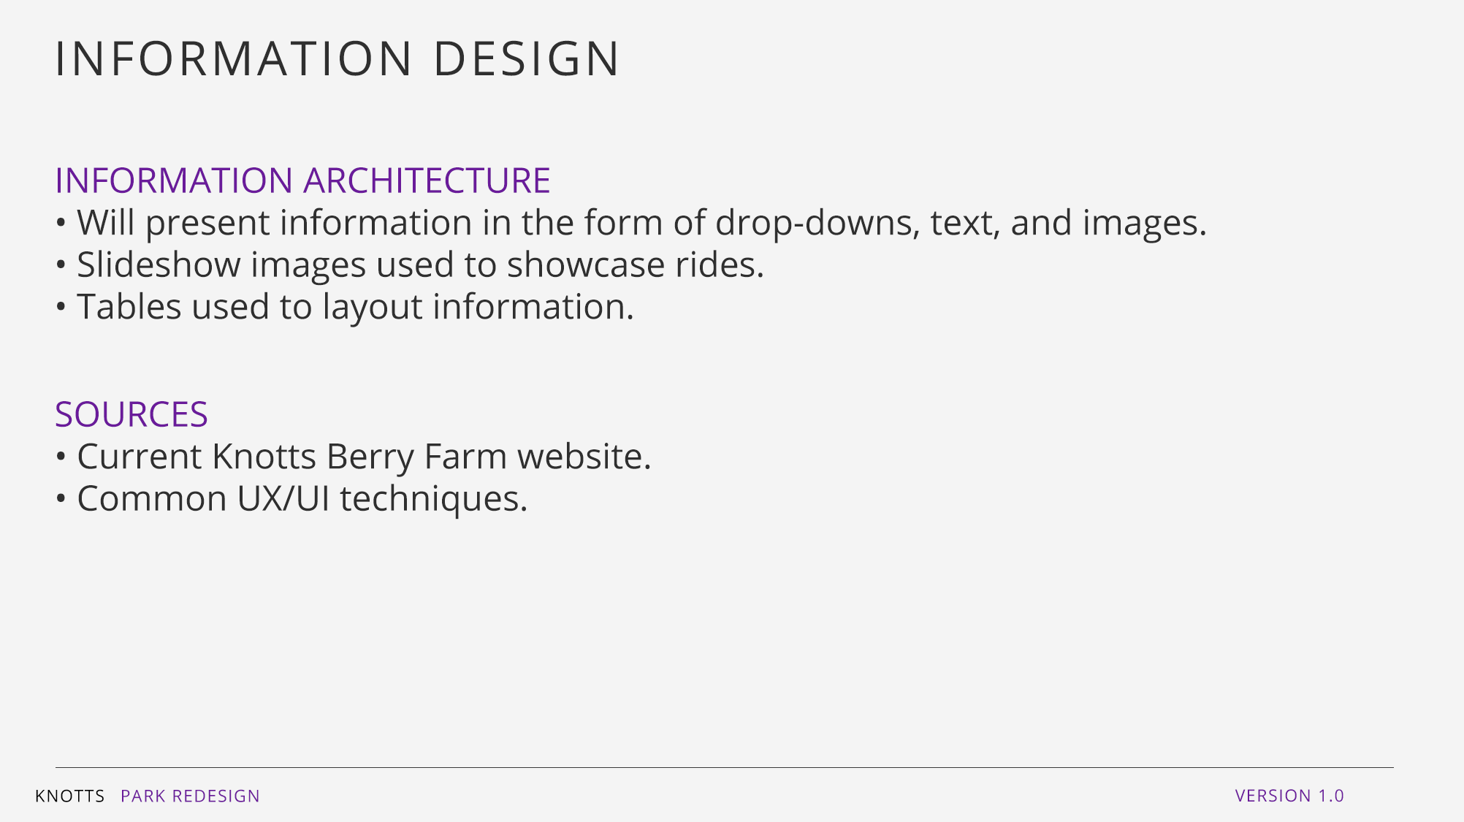
INFORMATION DESIGN & SOURCES
Information Design
Various dropdown links.
Categorizing products within Knots Berry Farm.
Sources
https://www.knotts.com/things-to-do
https://www.knotts.com/group-sales
https://www.knotts.com/

Slide 9
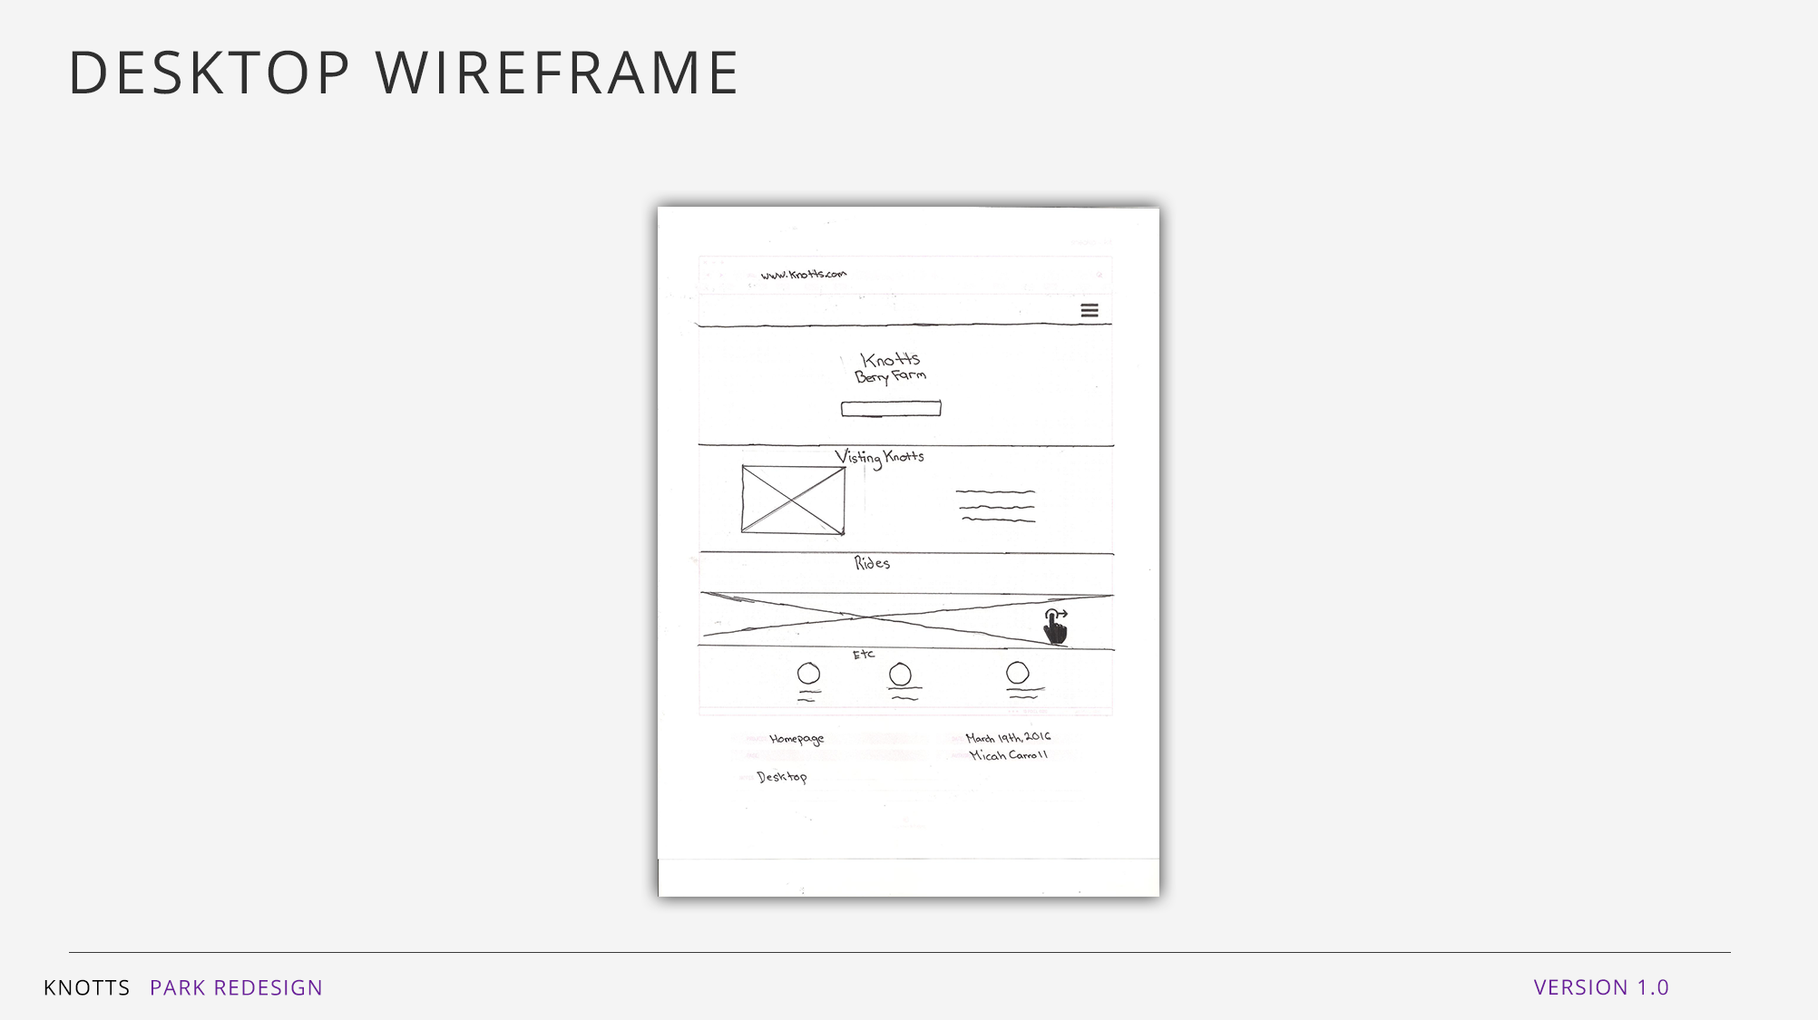
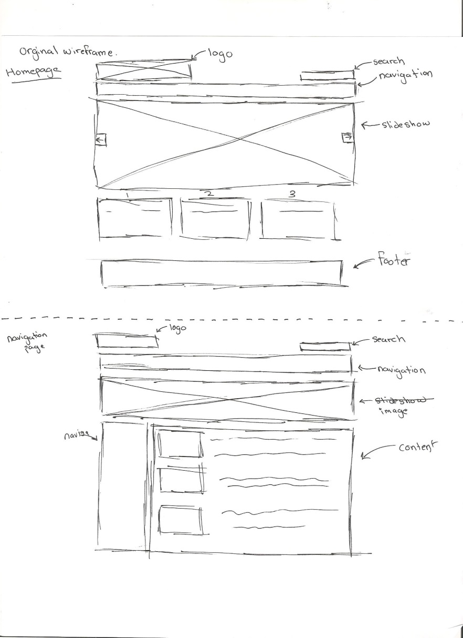
DRAWN WIREFRAMES

Slide 10
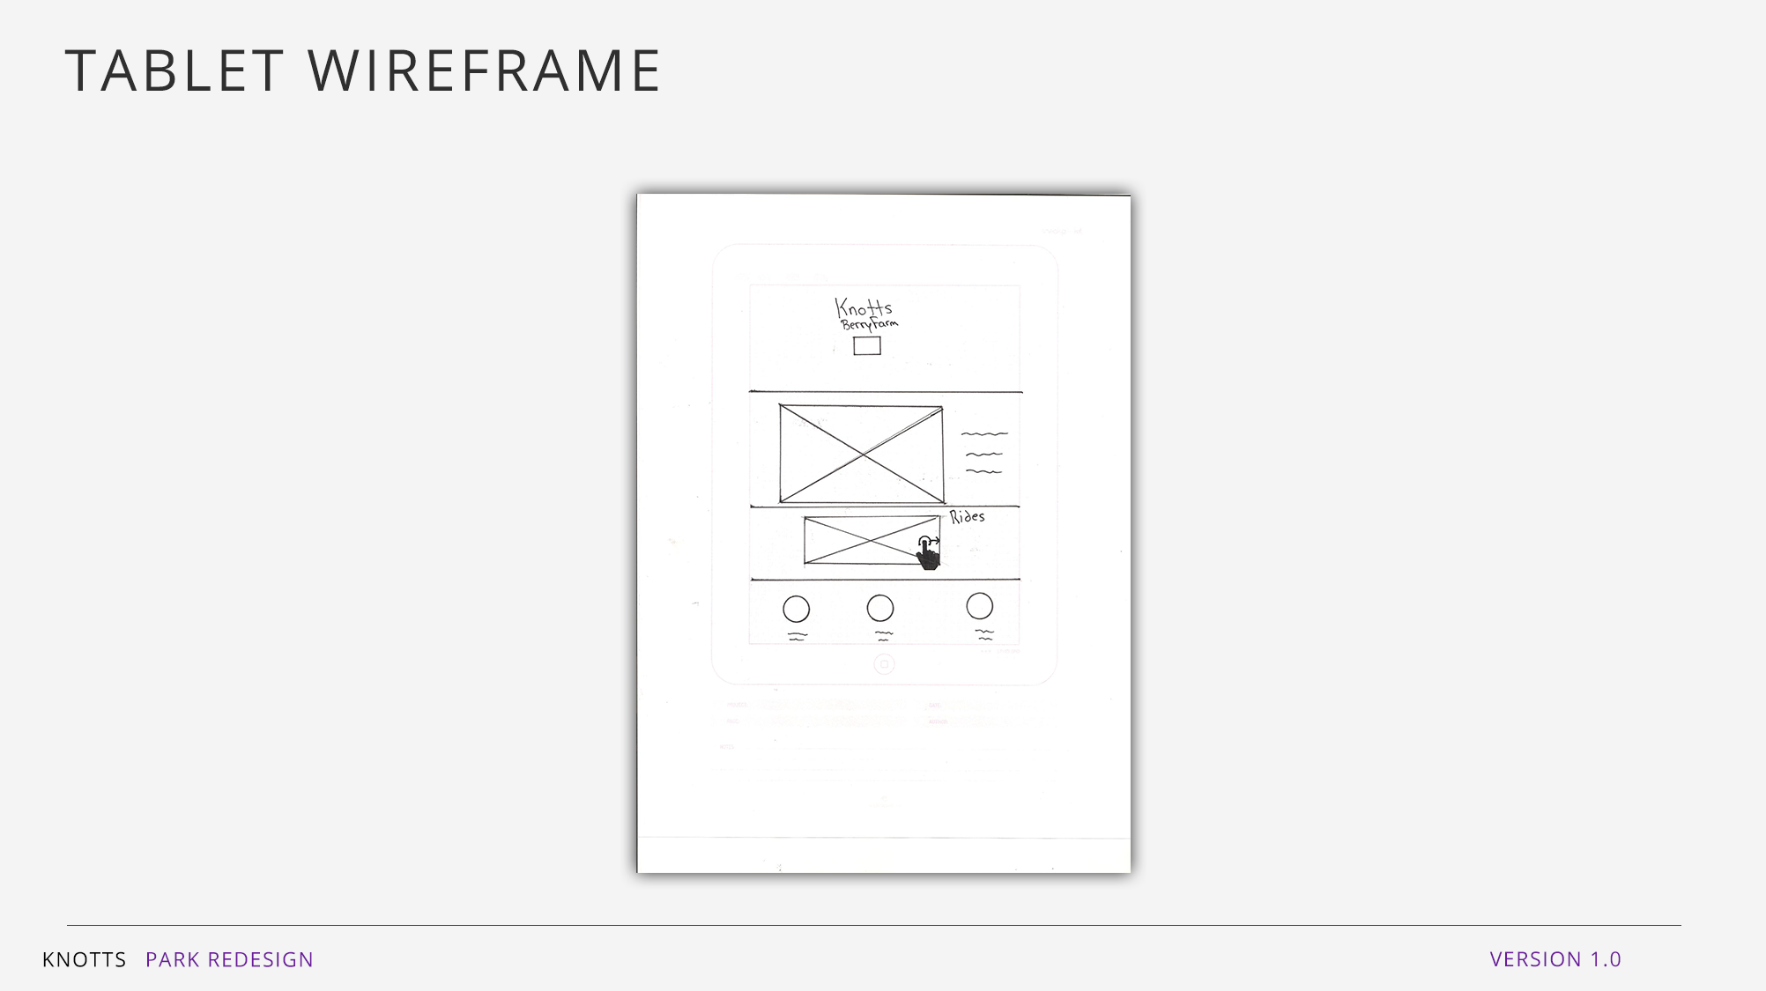
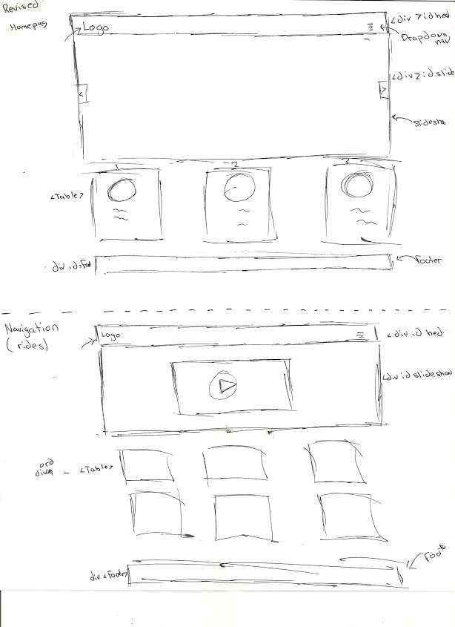
WIREFRAMES

Slide 11
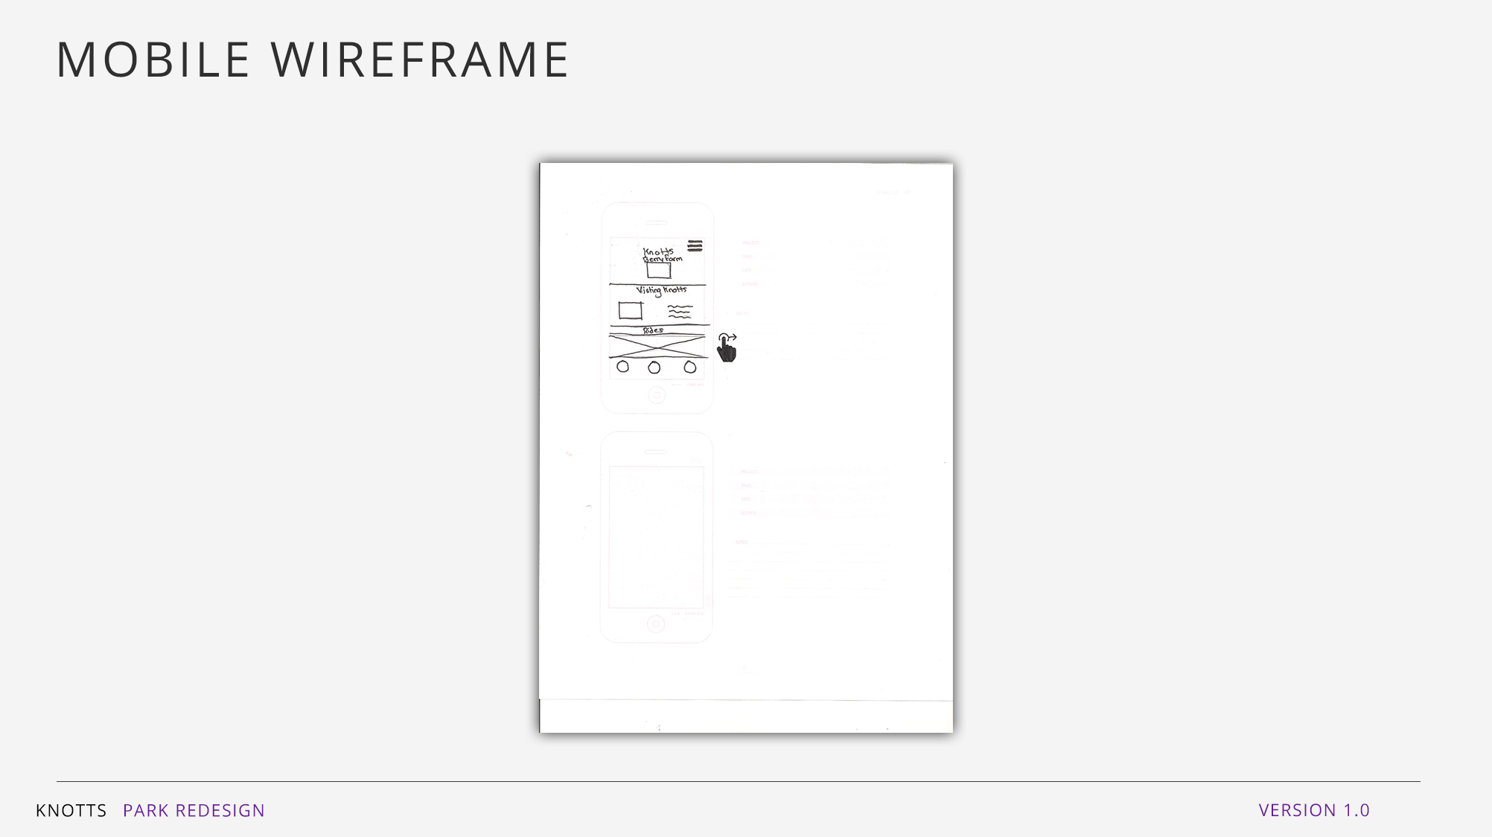

Slide 12
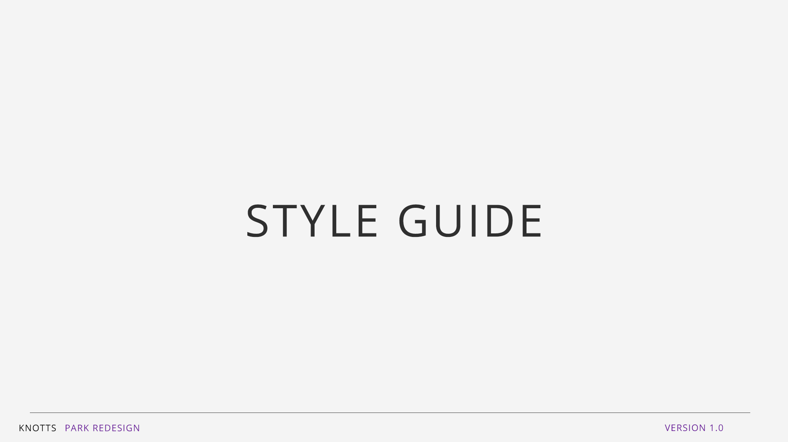

Slide 13
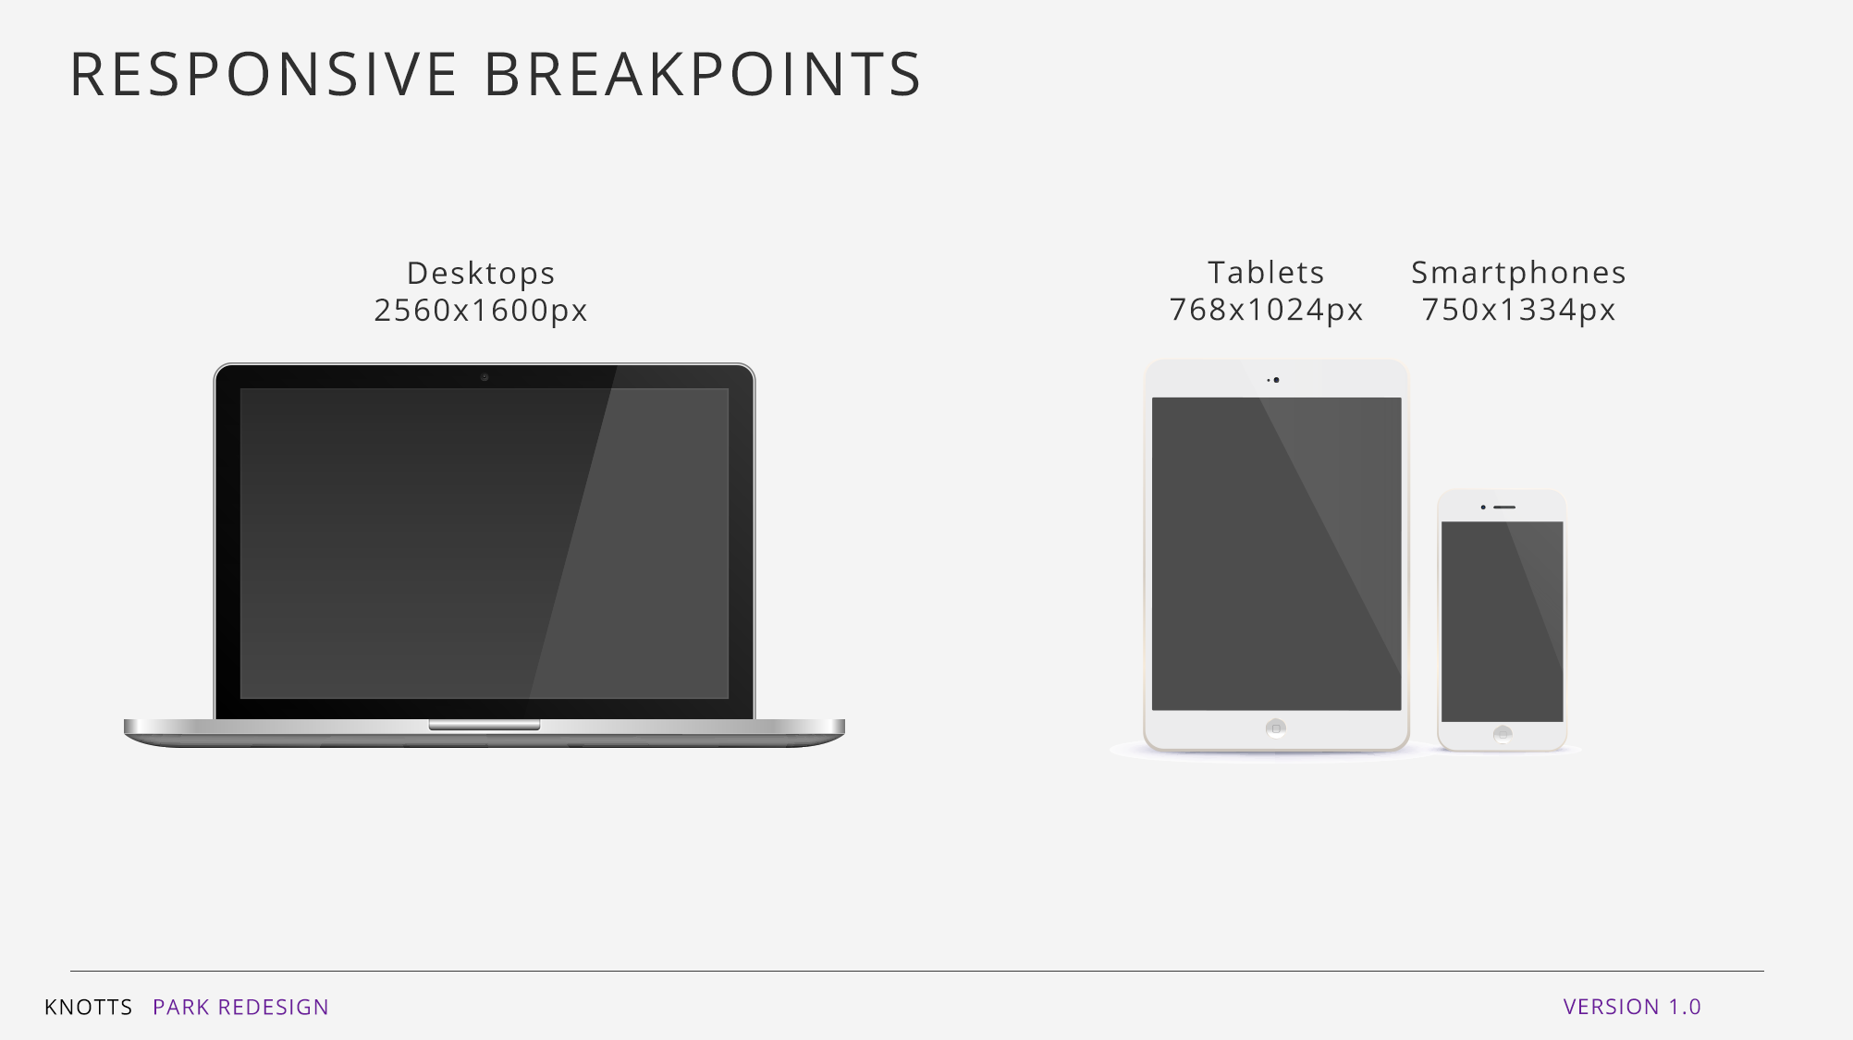
DESIGN BREAKPOINTS
Smartphones : 750x1334px
Tablets: 768x1024px
Desktops: 2560x1600px

Slide 14
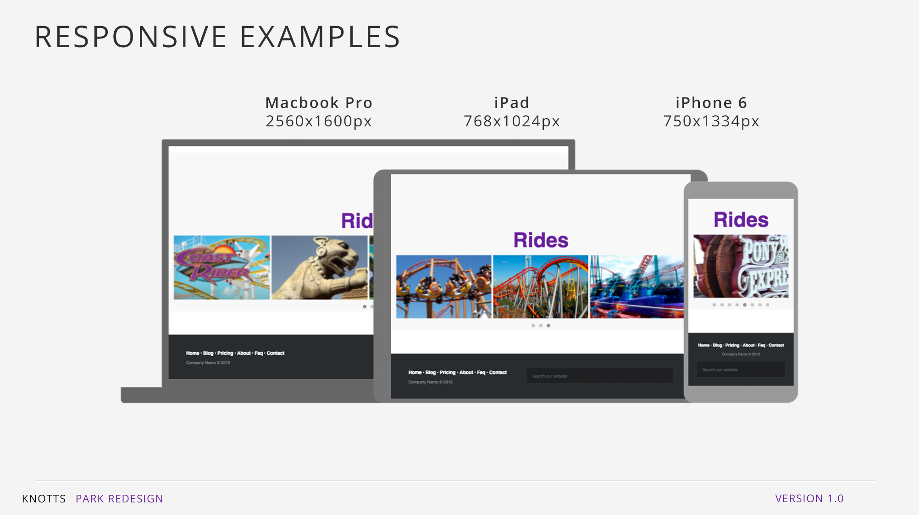

Slide 15
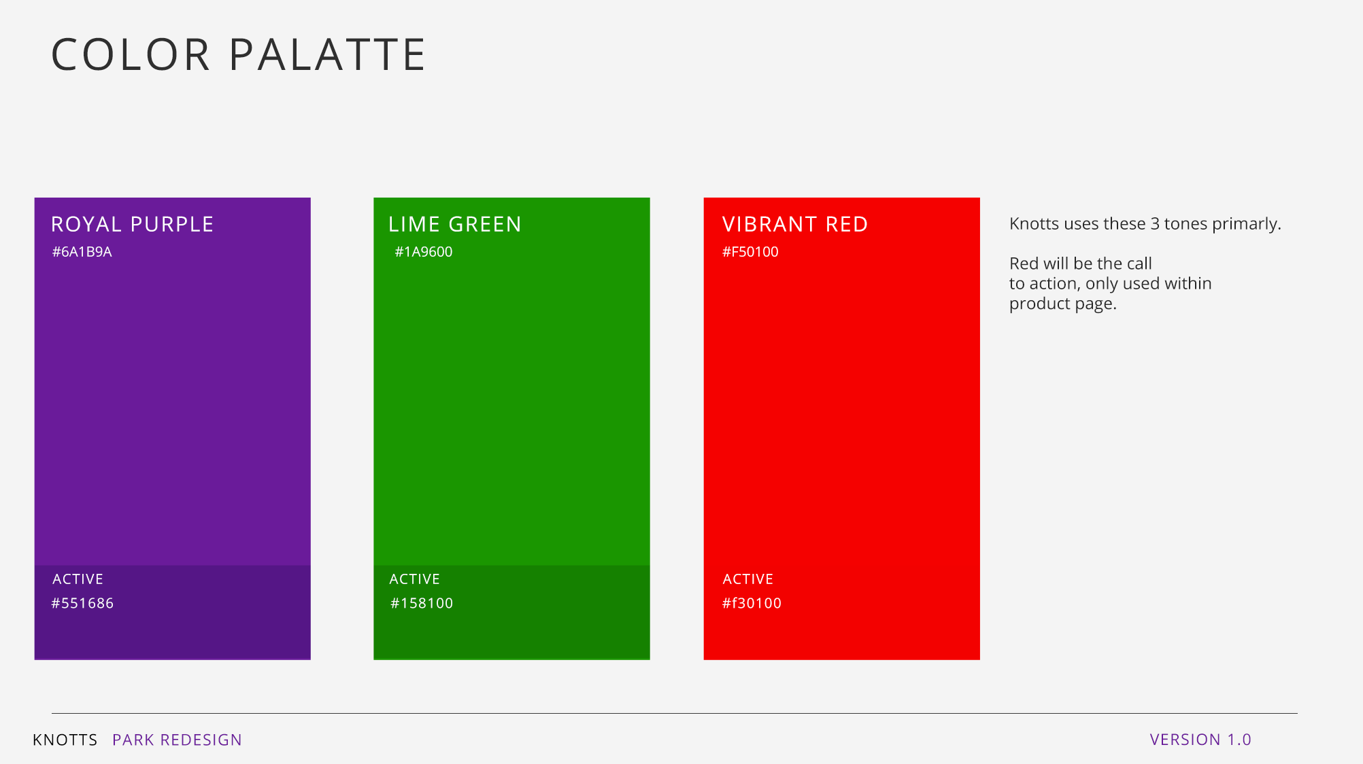

Slide 16
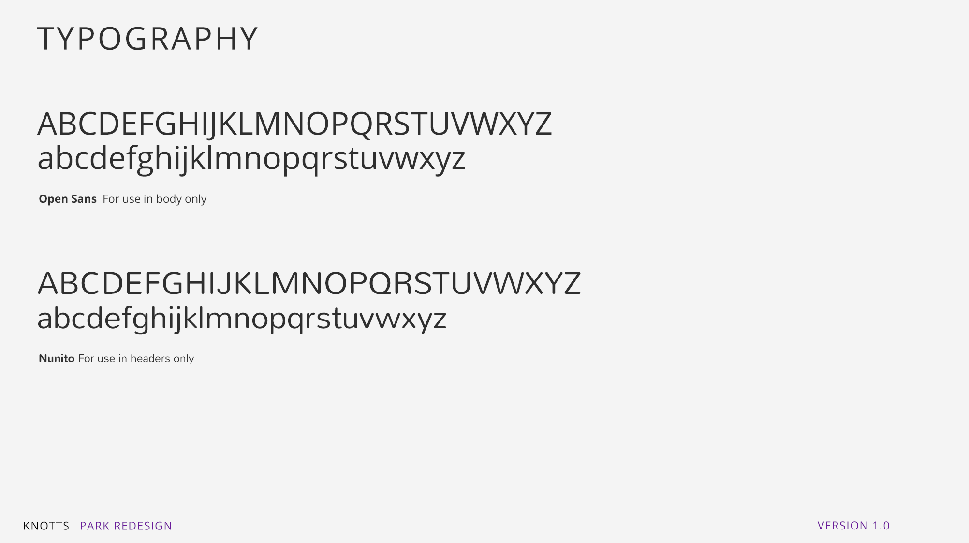

Slide 17
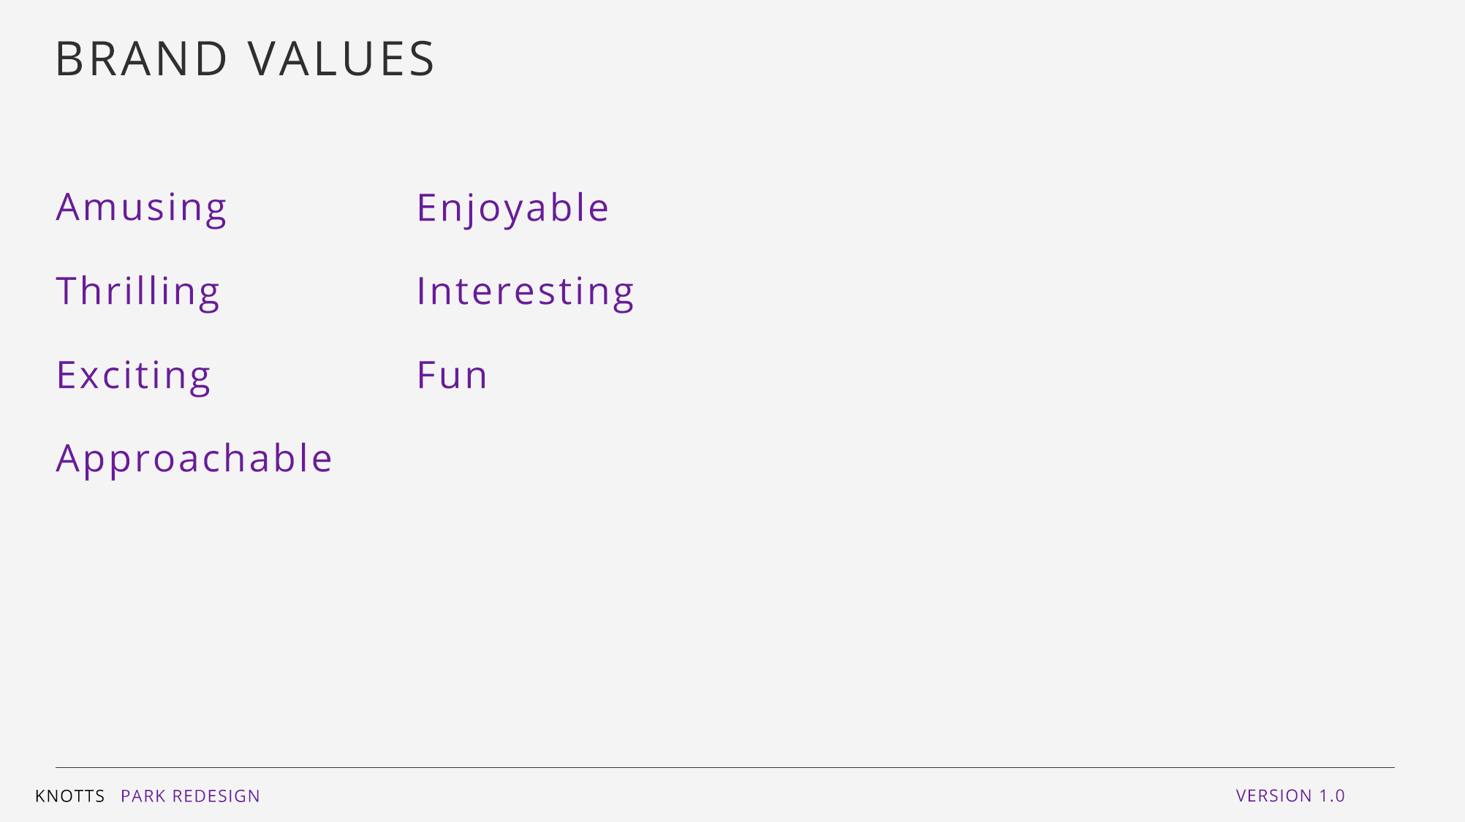

Slide 18
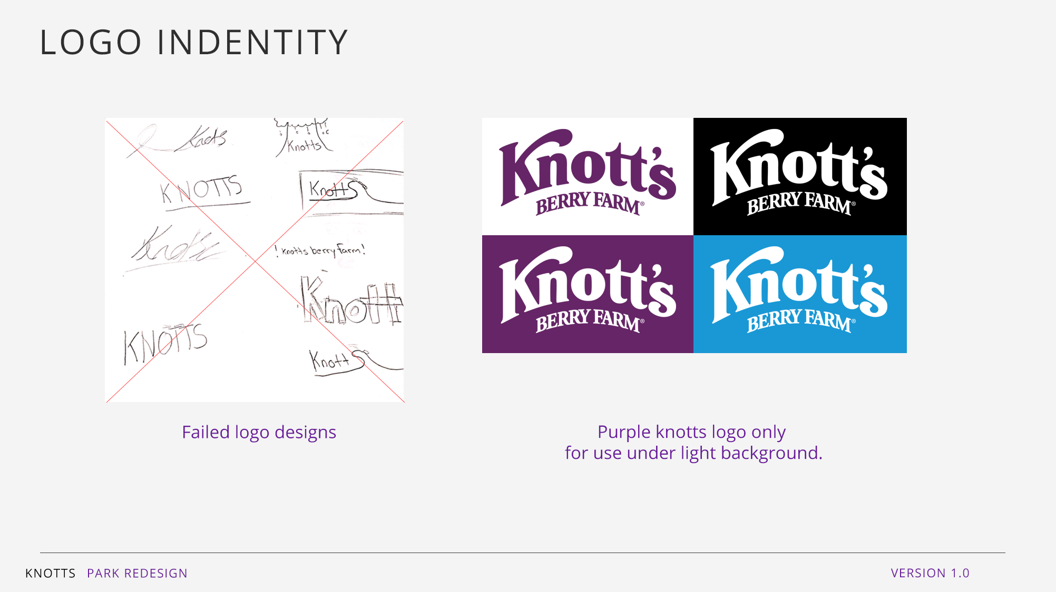
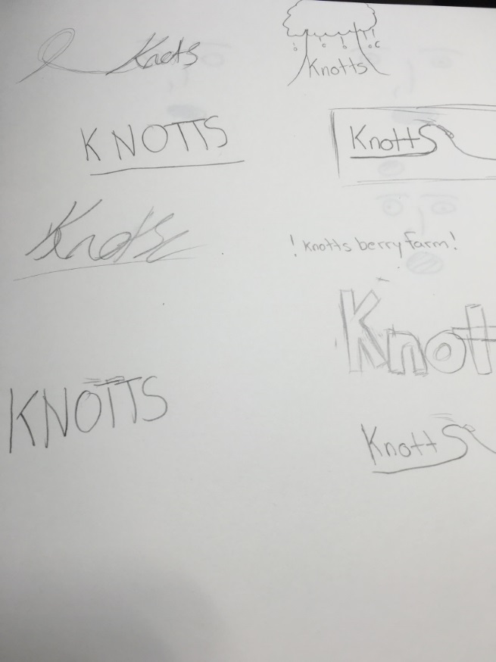
LOGO IDENTITY

Slide 19
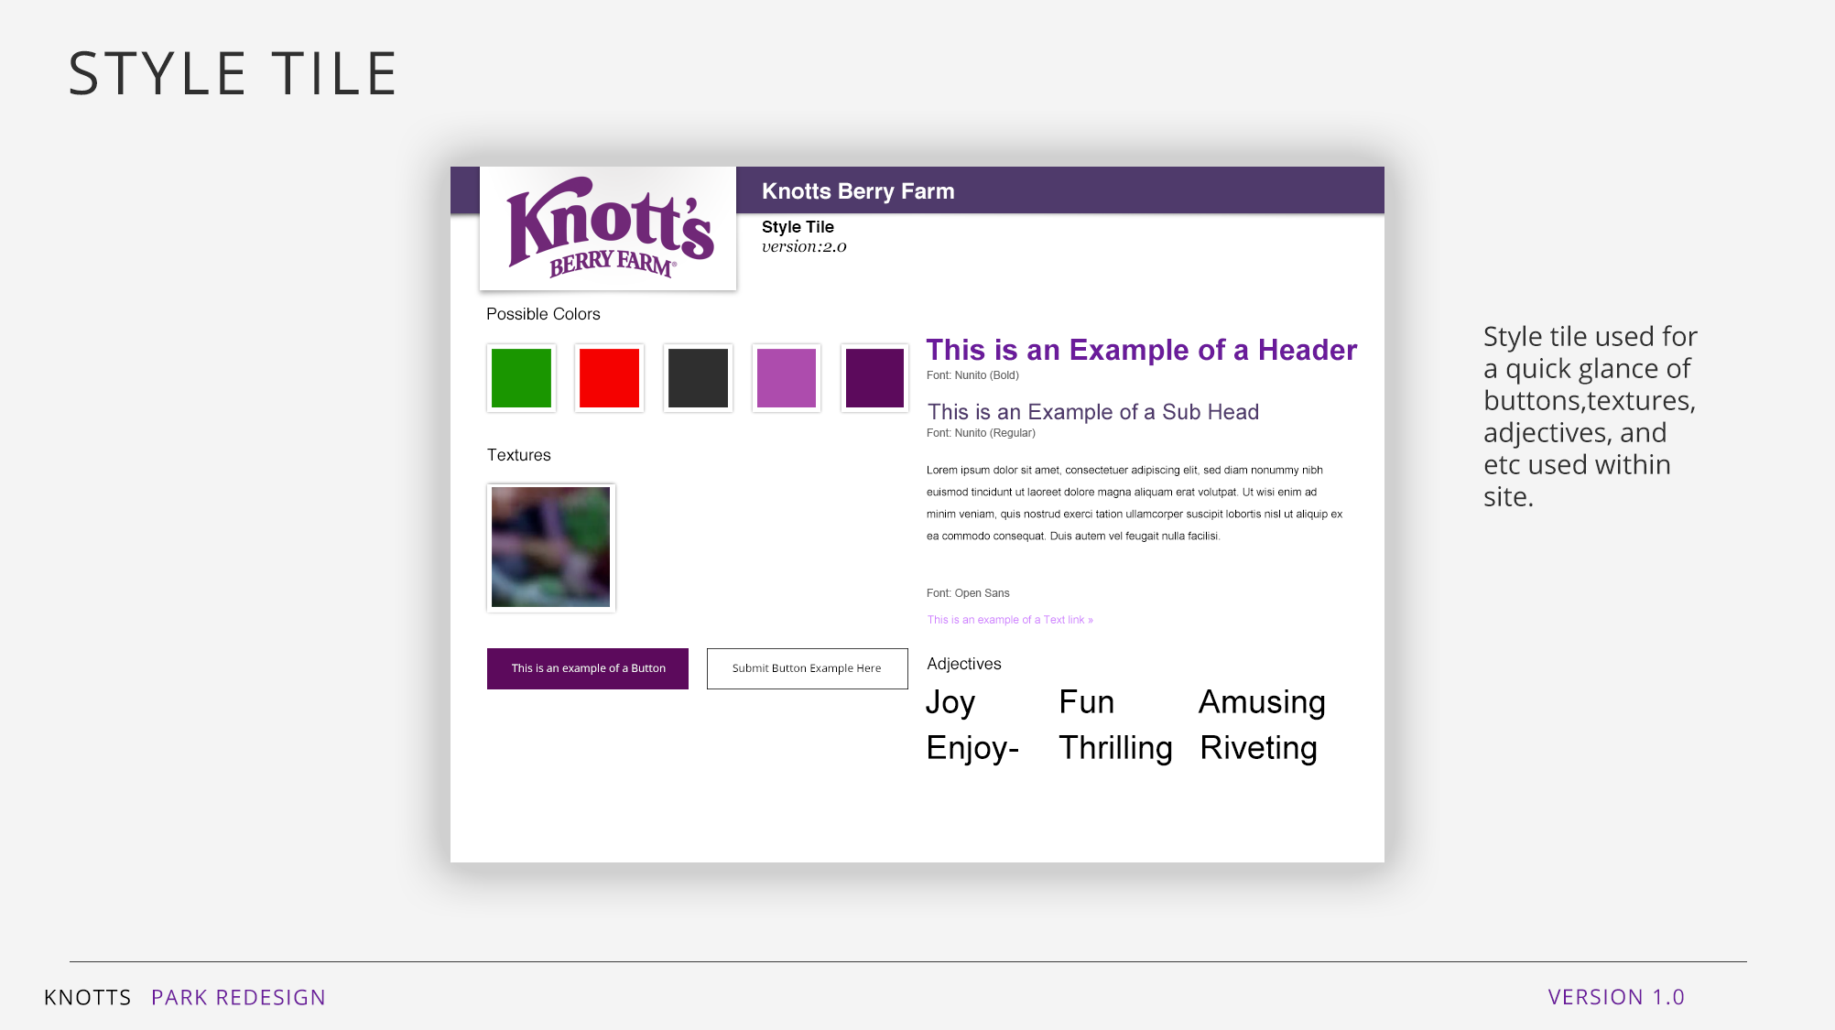

Slide 20
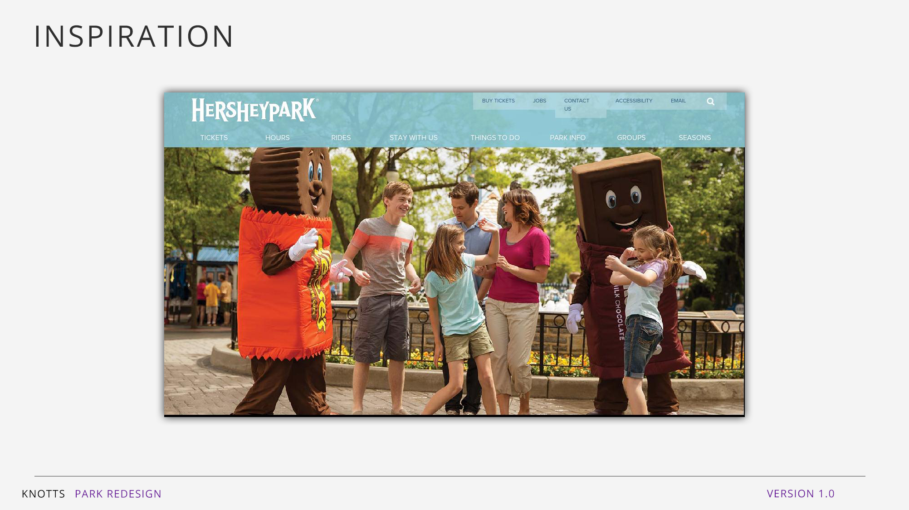

Slide 21
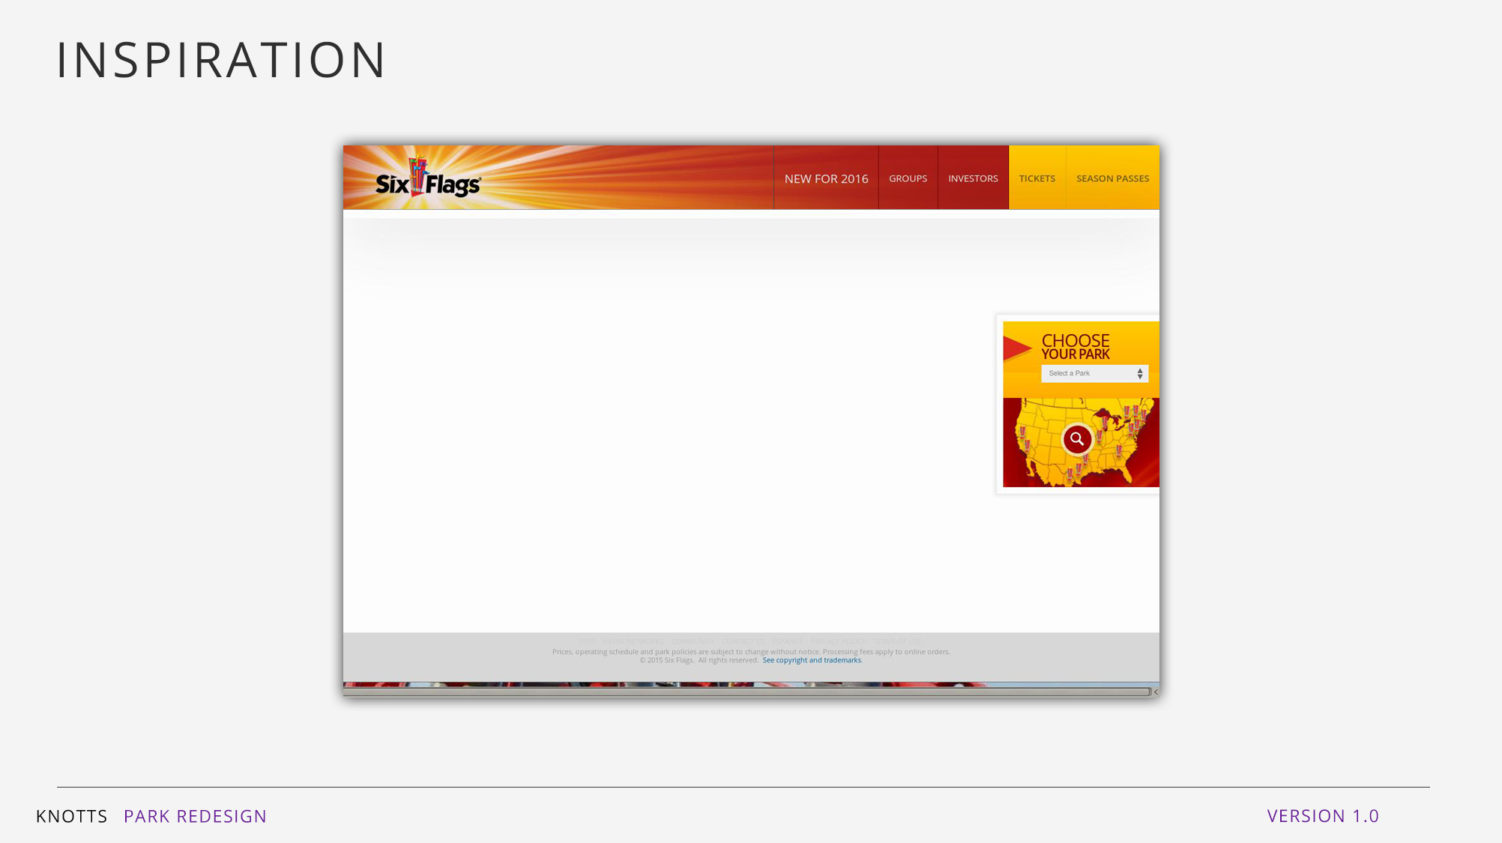

Slide 22
